Slide 1

Statistical Computation Methods for Data Science (6HC17)
By
Dr. Santhosh Nallapu
Assistant professor of Mathematics
Department of Science and Humanities
Sreenidhi Institute of Science and Technology
Yamnampet, Ghatkesar.
1
Notes:
1

Slide 2
We discuss the following in today’s Lecture
Regression Analysis
Simple Linear Regression
Estimating the Regression Coefficients
Assessing the Accuracy of the Coefficient Estimates
Assessing the Accuracy of the Model

Slide 3
Regression Analysis
Regression is one of the most widely used statistical technique, estimates relationships among variables. Regression models provide a very flexible framework for describing and testing hypotheses about relationships between explanatory variables and a response variable.
Typically, a regression analysis is used for the following purposes:
(1) modeling the relationship between variables.
(2) prediction of the target variable.
(3) testing of hypotheses.

Slide 4
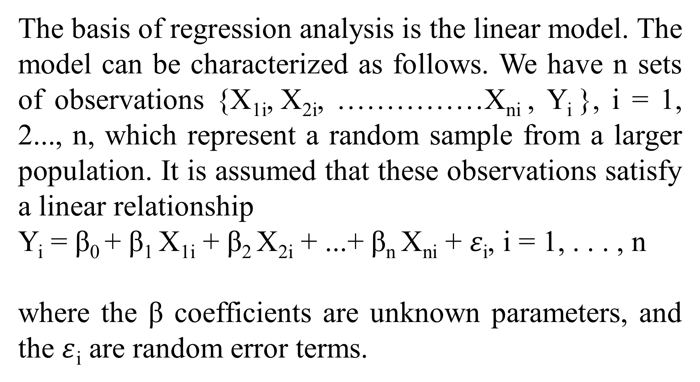
Regression Analysis
The basis of regression analysis is the linear model. The model can be characterized as follows. We have n sets of observations {X_{1i}, X_{2i}, ……………X_{ni} , Y_{i} }, i = 1, 2..., n, which represent a random sample from a larger population. It is assumed that these observations satisfy a linear relationship
Y_{i} = β₀ + β₁ X_{1i} + β₂ X_{2i} + ...+ β_{n} X_{ni} + $ε$_{i}, i = 1, . . . , n
where the β coefficients are unknown parameters, and the $ε$_{i} are random error terms.

Slide 5
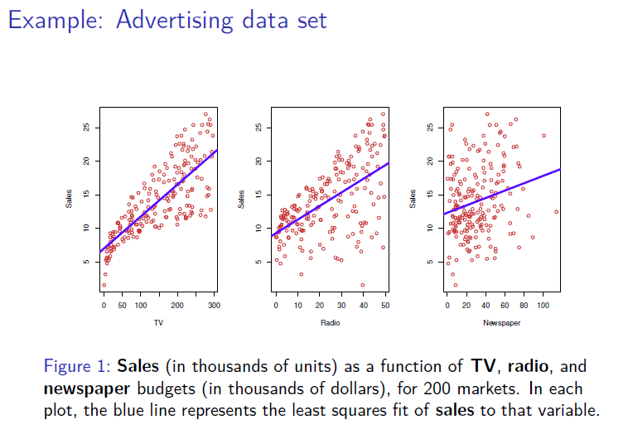

Slide 6
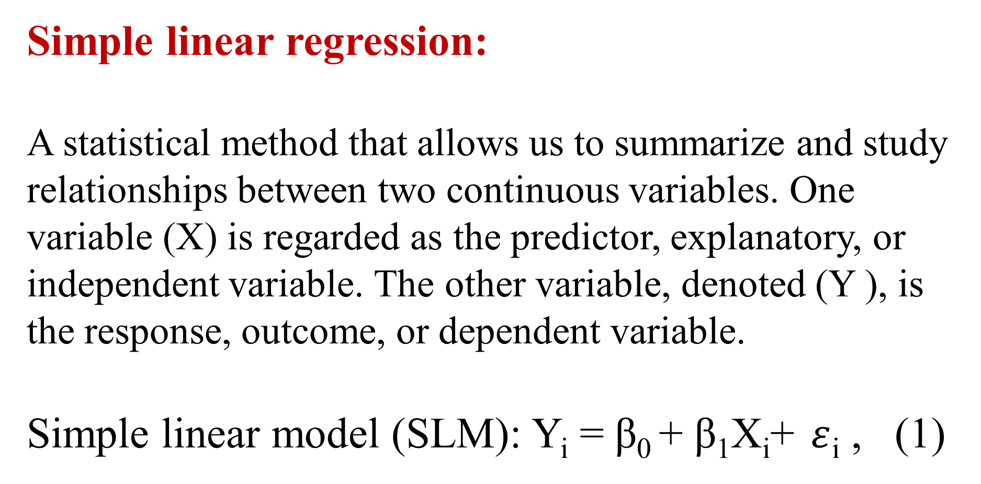
Simple linear regression:
A statistical method that allows us to summarize and study relationships between two continuous variables. One variable (X) is regarded as the predictor, explanatory, or independent variable. The other variable, denoted (Y ), is the response, outcome, or dependent variable.
Simple linear model (SLM): Y_{i} = β₀ + β₁X_{i}+ $ε$_{i} , (1)

Slide 7
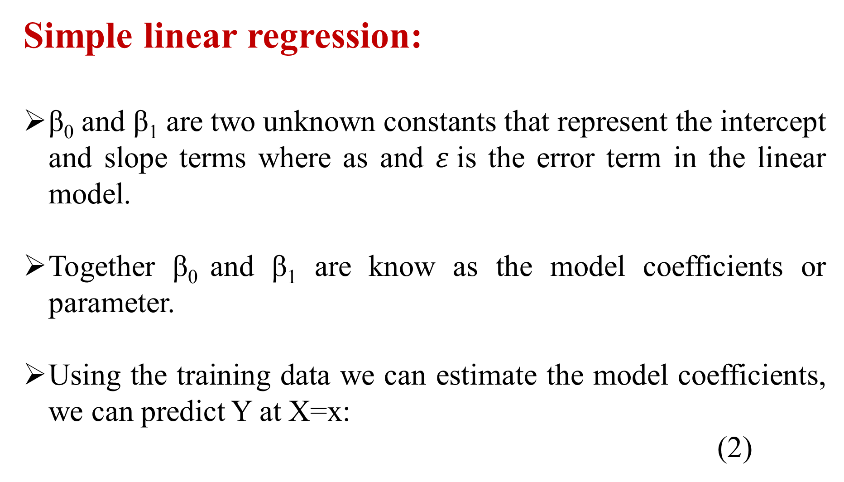
Simple linear regression:
β₀ and β₁ are two unknown constants that represent the intercept and slope terms where as and $ε$is the error term in the linear model.
Together β₀ and β₁ are know as the model coefficients or parameter.
Using the training data we can estimate the model coefficients, we can predict Y at X=x:
(2)

Slide 8
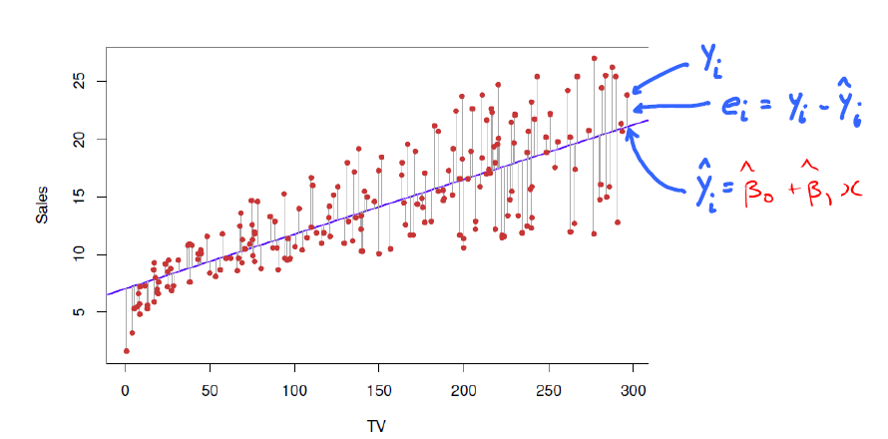
Least Squares estimation of the regression model
coefficients

Slide 9
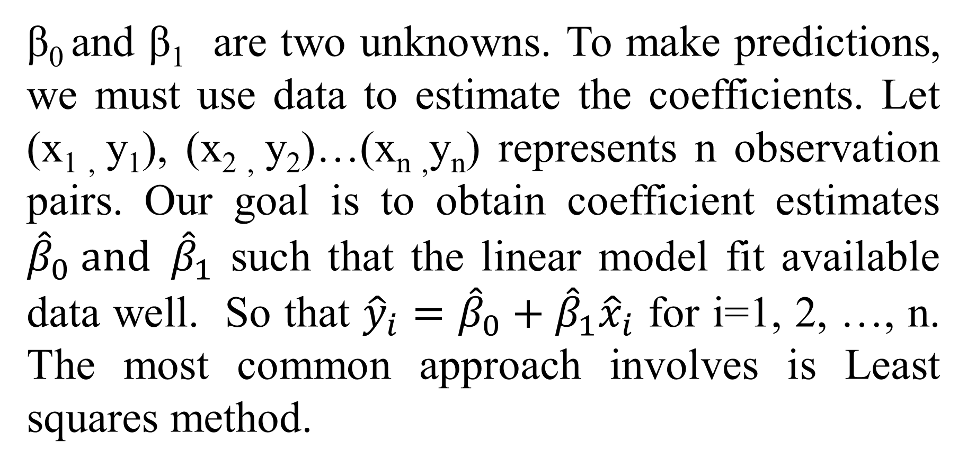
Estimating the Coefficients
β₀ and β₁ are two unknowns. To make predictions, we must use data to estimate the coefficients. Let (x_{1 ,} y₁), (x_{2 ,} y₂)…(x_{n ,}y_{n}) represents n observation pairs. Our goal is to obtain coefficient estimates ${\hat{β}}_{0} and {\hat{β}}_{1}$ such that the linear model fit available data well. So that ${\hat{y}}_{i}={\hat{β}}_{0}+{\hat{β}}_{1}{\hat{x}}_{i}$ for i=1, 2, …, n. The most common approach involves is Least squares method.

Slide 10
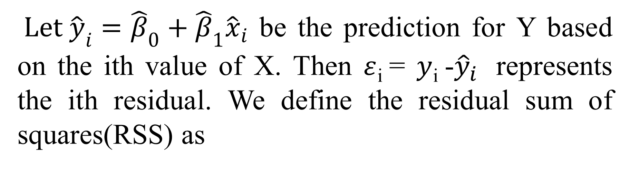
Estimating the Coefficients
$Let {\hat{y}}_{i}={\hat{β}}_{0}+{\hat{β}}_{1}{\hat{x}}_{i}$ be the prediction for Y based on the ith value of X. Then $ε$_{i} = $y$_{i} -${\hat{y}}_{i}$ represents the ith residual. We define the residual sum of squares(RSS) as

Slide 11
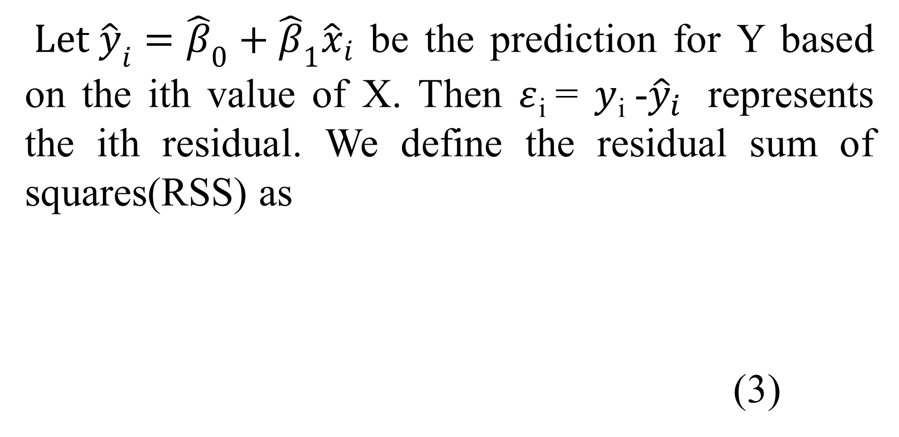
Estimating the Coefficients
$Let {\hat{y}}_{i}={\hat{β}}_{0}+{\hat{β}}_{1}{\hat{x}}_{i}$ be the prediction for Y based on the ith value of X. Then $ε$_{i} = $y$_{i} -${\hat{y}}_{i}$ represents the ith residual. We define the residual sum of squares(RSS) as
(3)

Slide 12
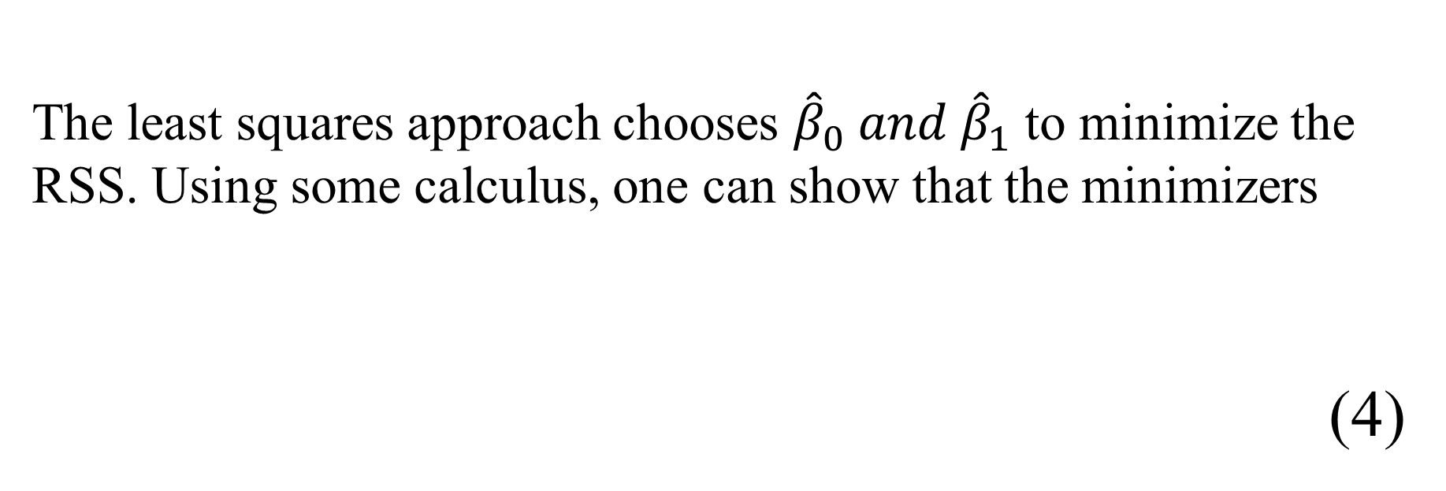
The least squares approach chooses ${\hat{β}}_{0} and {\hat{β}}_{1}$ to minimize the RSS. Using some calculus, one can show that the minimizers
(4)
Eq. (4) the least squares coefficient estimates for simple linear regression.

Slide 13
Assessing the Accuracy of the Coefficient Estimates
The estimated coefficients and the regression line depend on the training data
The training data are a "random sample" from the population, and thus the coefficient estimates are also
random.
That is, if we got a different sample of training data, we'd get different estimates of the intercept and slope
of the line.

Slide 14
The sampling distribution of the estimates depends on the sampling model.
Typical assumptions are
i) the error terms are independent of each other across observations
ii) the variance of the errors are the same across observations
iii) the error terms are normally distributed
Note : With these assumptions, we can obtain the sampling variances of our estimates. The square roots of these variances are the standard errors of the estimators, and are given by:

Slide 15
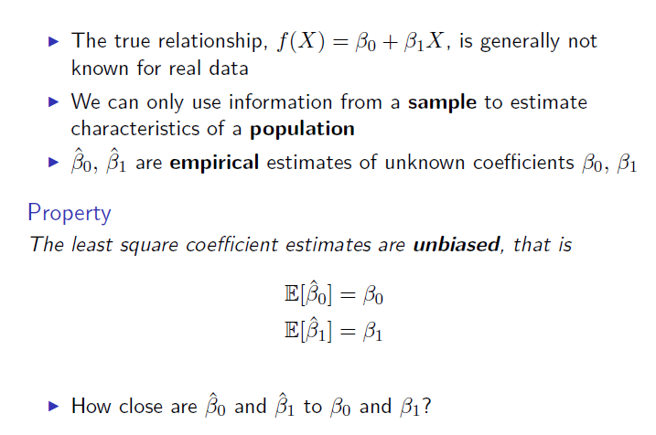
Assessing the Accuracy of the Coefficient Estimates

Slide 16
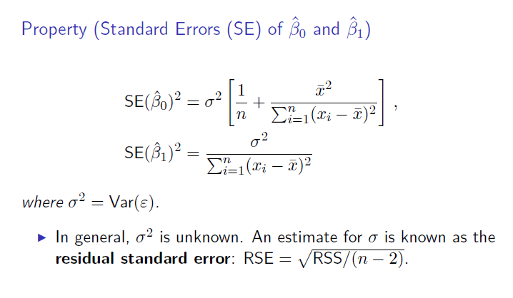
Assessing the Accuracy of the Coefficient Estimates

Slide 17
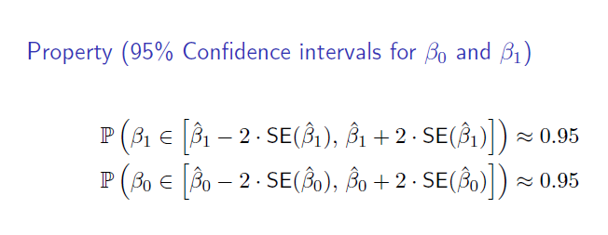
Assessing the Accuracy of the Coefficient Estimates

Slide 18
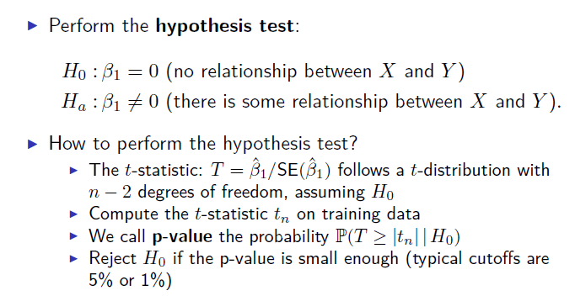
Assessing the Accuracy of the Coefficient Estimates

Slide 19
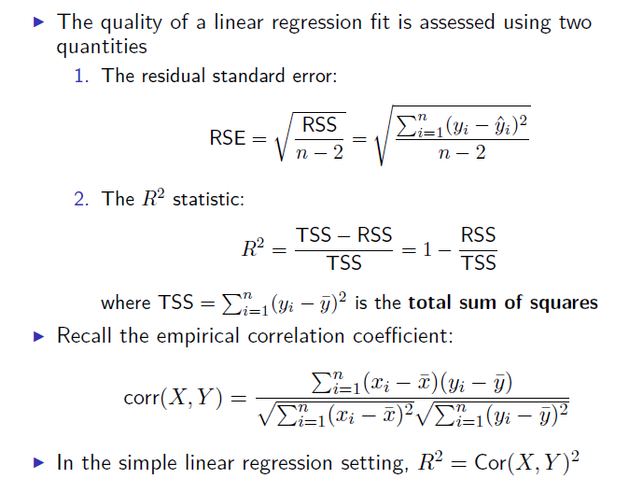
Assessing the accuracy of the model

Slide 20
Recapitulation:
Regression Analysis
Simple Linear Regression
Estimating the Regression Coefficients
Assessing the Accuracy of the Coefficient Estimates
Assessing the Accuracy of the Model

Slide 21
THANK YOU
Feed Back to santhoshn@sreenidhi.edu.in
Notes:
21

